Slide 1
CAST analysis And Action Plan (Smart Dispatch Tool (SDT))

Slide 2
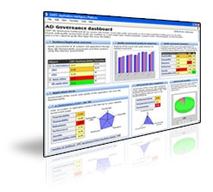
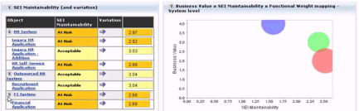
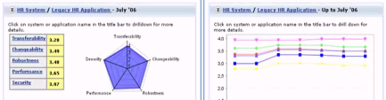
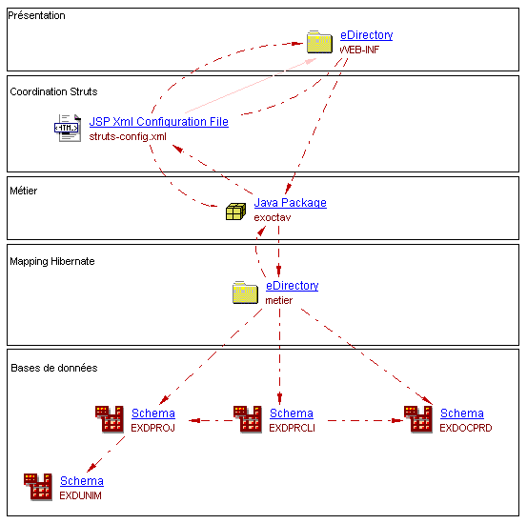
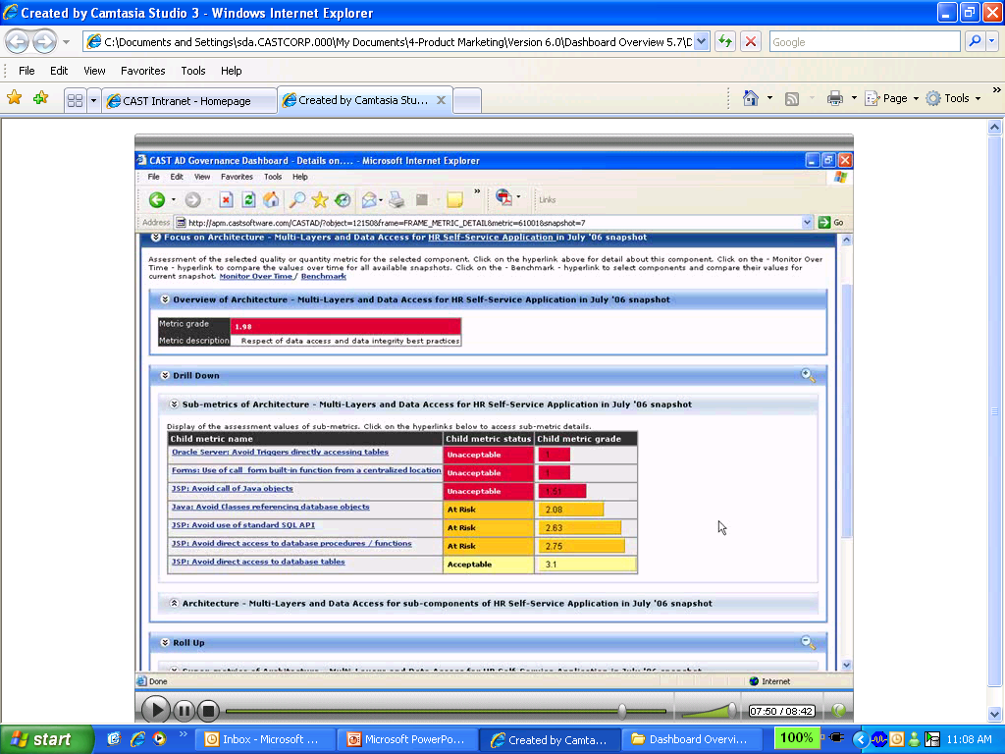
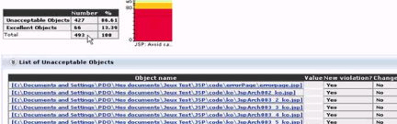
CAST - Application Intelligence Platform
l
ANALYZERS
APPLICATION KNOWLEDGE BASE
AD GOVERNANCE DASHBOARD
Oracle PL/SQL
Sybase T-SQL
SQL Server T-SQL
IBM SQL/PSM
C, C++, C#
Pro C
Cobol
CICS
Visual Basic
VB.Net
ASP.Net
Java, J2EE
JSP
XML
HTML
Javascript
VBScript
PHP
PowerBuilder
Oracle Forms
PeopleSoft
SAPABAP, Netweaver
Tibco
Business Objects
Universal Analyzer for other languages
APPLICATION HEALTH
MANAGEMENT VISIBILITY
Total Quality Index(TQI)
TECHNICAL METRICS
To asses, monitor, and improve applications, development teams and outsourcers
Immediate Impact
On-going Impact
Robustness
Transferability
Performance
Changeability
Security
APPLICATION SIZE
DRILL-DOWN TO ACTION
Technical Size
Functional Weight
Overview…
Portfolio
Applications
Health factors
TECHNICAL INVENTORY
APPLICATION METADATA
Modules
Over 1000 rules and best practices
Compliance
Objects
Sub- metrics
Rules
… to remediation
Achieve higher quality at less cost

Slide 3
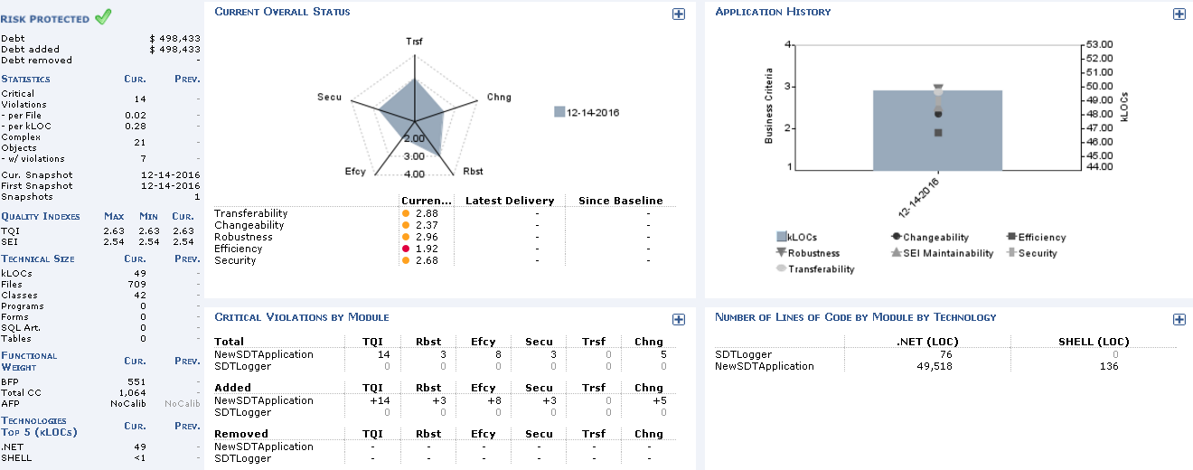
Analysis- CAST Scan Results
SDT Code Analysis

Slide 4
SDT Background
Problem Statement
Code Quality
Gaps in Impact Analysis
Performance Issues
The Solution
CAST
The Team
SDT Team

Slide 5
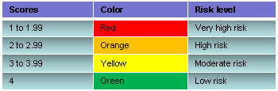

CAST scan results of SDT – Technical Summary
Application Health
Transferability | 2.88
Changeability | 2.37
Robustness | 2.96
Efficiency | 1.92
Security | 2.68
Application Rule Compliance
Programming Practices | 2.53
Architectural Design | 2.51
Documentation | 2.89
TQI – 2.63
Average Capgemini Dot Net TQI is 3.44; Industry Benchmark for Dot Net is (2.9 – 3.0)
Key Violations
Efficiency(Performance)
Avoid large number of String concatenation
Avoid instantiations inside loops
Changeability
Avoid declaring public Fields
Avoid Too Many Copy Pasted Artifacts
Transferability
Avoid undocumented Classes
Avoid Artifacts with high Commented-out Code Lines/Code Lines ratio
Key Metrics
Total KLOC | 49
% of Highly complex artifacts | 0.54
Critical Violations per KLOC | 0.28

Slide 6
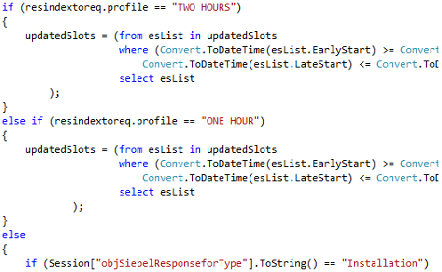

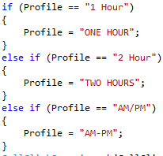
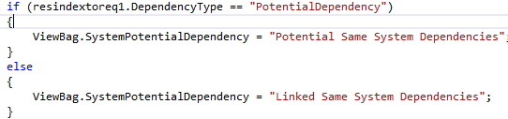
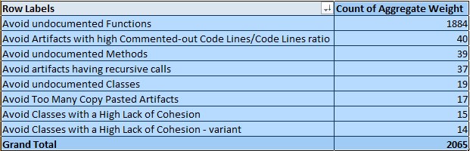
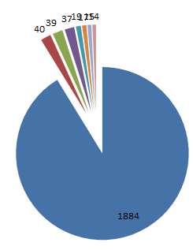
Key Analysis
Hardcodings.
Heavy use of Session objects.
Un used methods to be removed

Slide 7
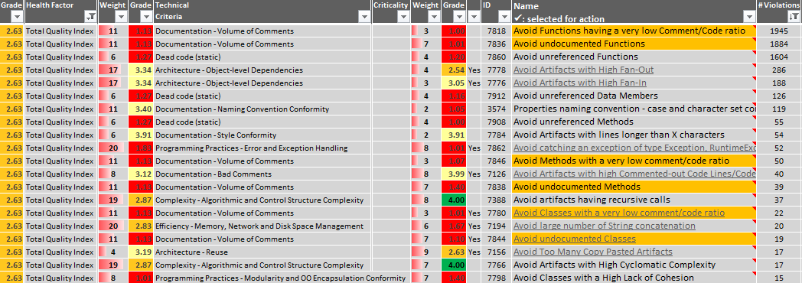
Key Analysis (Cont..)
TQI rules violated is more critical which have high weightage and lowest Grade.
First target will be to put comments to methods and functions.
It will be validated against team’s code understanding and their functional knowledge which will help team understand the system functionality.

Slide 8





Key Violations – Efficiency(Performance)
High-Impact Violations - Efficiency(Performance)
Technical Criterion | Rule Name
Efficiency – Memory, Network and Disk Space management | Avoid large number of String concatenation
Efficiency – Expensive Calls in Loops | Avoid instantiations inside loops
Efficiency – Memory, Network and Disk Space management | Declare as static all Methods not using Instance Fields
Efficiency – Memory, Network and Disk Space management | Provide a private default Constructor for utility Classes
Efficiency – Expensive Calls in Loops | Avoid String concatenation in loops
Low risk areas – Efficiency(Performance)
Technical Criterion | Rule Name
Efficiency – Expensive Calls in Loops | Avoid the use of IF inside loops
Efficiency – Memory, Network and Disk Space management | Close SQL connection ASAP
High impact violation examples
Object: NewSDTApplication.Utilities.GoogleAPIKeyEncoder.GoogleKey
Object: NewSDTApplication.Utilities.SSOLogic.GetSSODetails

Slide 9
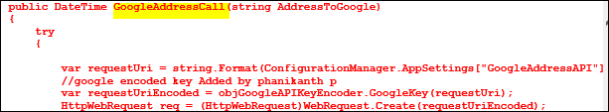

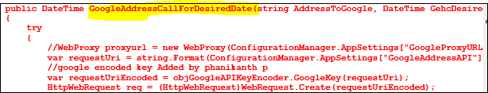
Key Violations – Changeability
High-Impact Violations - Changeability
Technical Criterion | Rule Name
Programming Practices - Modularity and OO Encapsulation | Avoid declaring public Fields
Architecture Reuse | Avoid Too Many Copy Pasted Artifacts
Programming Practices – Structuredness | Avoid using a break statement in 'for' loops
Architecture - Object Level Dependencies | Avoid Artifacts with High Fan-In
Architecture - Object Level Dependencies | Avoid Artifacts with High Fan-Out
Low risk areas - Changeability
Technical Criterion | Rule Name
Architecture – Multi Layers and Data Access | User Interface elements must not use directly the database
Programming Practices – Structuredness | Avoid using GOTO statement
High impact violation examples
Object: NewSDTApplication.Program.AccessToken.OAuthAuthentication.OAuthUri
Object:NewSDTApplication.Utilities.CountriesTimeZoneConversion.GoogleAddressCall AND NewSDTApplication.Utilities.CountriesTimeZoneConversion.GoogleAddressCallForDesiredDate

Slide 10

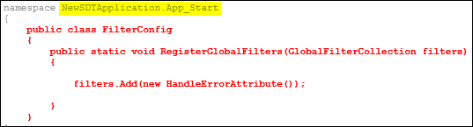
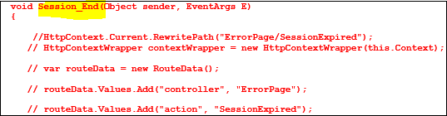
Key Violations – Transferability
High-Impact Violations - Transferability
Technical Criterion | Rule Name
Documentation volume of Comments | Avoid undocumented Classes
Documentation – Bad Comments | Avoid Artifacts with high Commented-out Code Lines/Code Lines ratio
Complexity – Algorithmic and Control Structure Complexity | Avoid Artifacts with too many parameters
Documentation - Naming Convention Conformity | Private Fields naming convention - case and character set control
Documentation volume of Comments | Avoid Classes with a very low comment/code ratio
Low risk areas - Transferability
Technical Criterion | Rule Name
Complexity – Algorithmic and Control Structure Complexity | Avoid Artifacts with High Depth of Code
Complexity – Algorithmic and Control Structure Complexity | Avoid artifacts having recursive calls
Complexity – OO Inheritance and Polymorphism | Avoid large Classes - too many Constructors
High impact violation examples
Object: NewSDTApplication.App_Start.FilterConfig
Object: NewSDTApplication.MvcApplication.Session_End

Slide 11
Action plan
Preventive action plan: The rules are identified along with the preventive action planned for each rule.
Rule | Training planned | IDE tool configuration planned | Standards to be enhanced
Avoid too many copy pasted artifacts | Y | Analyze the plug-in integration with Visual Studio | 1. Prepare coding standards 2. Checks and balance in place 3. Team awareness in Team meetings
Avoid undocumented Classes | Y
Avoid undocumented Methods | Y
Avoid instantiations inside loops | Y
Avoid declaring public Fields | Y
Avoid instantiations inside loops | Y
Avoid String concatenation in loops | Y
Avoid artifacts having recursive calls | Y
Corrective action plan: The detailed corrective action plan is as attached. The rules and objects are selected based on criticality of modules, pain points, TQI improvement, Health factor improvement etc.
The summary of the action plan is as shown below.

Slide 12
Thank you

